Slide 1

Synchronization
Lecturer: VU THI MY HANG
Operating System

Slide 2
Plan
Critical Section Problem
Synchronization
Classic synchronization problems

Slide 3
Plan
Critical Section Problem
Synchronization
Classic synchronization problems

Slide 4
Race condition
Critical Section Problem
What if several processes/threads access a shared variable concurrently?
☹ Data inconsistencies and errors
Int availTicket = 1;
Client A ( ) {
if (availTicket > 0) {
availTicket -= 1;
}
}
Client B ( ) {
if (availTicket > 0) {
availTicket -= 1;
}
}
1
2
4
3
availTicket = -1

Slide 5
Critical Section Problem
Critical Section Problem
Int availTicket = 1;
Client A ( ) {
if (availTicket > 0) {
availTicket -= 1;
}
}
Client B ( ) {
if (availTicket > 0) {
availTicket -= 1;
}
}
Critical Section (CS):
Code segment in which multiple processes/threads access shared resources concurrently
(e.g., availTicket)
Solution: synchronization

Slide 6
Plan
Critical Section Problem
Synchronization
Busy Waiting Solutions
Sleep and Wakeup Solutions
Classic synchronization problems

Slide 7
Synchronization Requirements
Synchronization
Mutual Exclusion
Only one process/thread can be executing inside a critical section at a time
Progress
A process/thread outside a critical section cannot block others to enter this critical section
Bounded Waiting
Processes/Threads should not wait indefinitely for entering a critical section

Slide 8
Synchronization Solutions
Synchronization
Busy Waiting
Sleep and Wakeup
while (no permission to enter CS);
critical_section;
if (no permission to enter CS) sleep();
critical_section;
wake_up(another);
Software solutions
Lock variable
Strict Alternation
Peterson’s solution
Hardware solutions
Interrupt disabling
TSL
Semaphore
Binary semaphore (mutex)
Counting semaphore
Monitor

Slide 9
Lock variable
Synchronization | Busy Waiting Solutions
int lock = 0;
Process_A() {
while (1) {
while (lock);
lock = 1;
critical_section;
lock = 0;
…
}
}
Process_B() {
while (1) {
while (lock);
lock = 1;
critical_section;
lock = 0;
…
}
}
☹ Two processes/threads may be inside CS at a time

Slide 10
Strict Alternation
Synchronization | Busy Waiting Solutions
int turn = 0;
Process_A() {
while (1) {
while (turn != 0);
critical_section;
turn = 1;
…
}
}
Process_B() {
while (1) {
while (turn != 1);
critical_section;
turn = 0;
…
}
}
☹ A process/thread outside CS may prevent another thread from entering CS

Slide 11
Peterson’s solution
Synchronization | Busy Waiting Solutions
#define N 2 //two processes/threads solution
int turn; //current turn
int interested[N]; //initial value = 0, N: number of threads
enterCS (int process) {//process = 0 or 1
int other = 1 – process;
interested[process] = 1;
turn = other;
while (turn == other &&
interested[other] == 1);
}
leaveCS (int process) {
interested[process] = 0;
}
Process_A() {
while(1){
enterCS(0);
critical_section;
leaveCS(0);
}
}
Process_B() {
while(1){
enterCS(1);
critical_section;
leaveCS(1);
}
}
☹ CPU wasting
☹ Priority Inversion

Slide 12
Interrupt Disabling Hardware support
Synchronization | Busy Waiting Solutions
Interrupts: signals emitted by a hardware or a software
Timer Interrupts: handle CPU Scheduling
I/O device Interrupts: inform I/O completion
...
➔ Perform a context switch
Interrupt-based solution for critical section problem
Disable interrupts
Enter CS
critical_section
Leave CS
Enable interrupts
No interrupts
→ No CPU Scheduling
→ No critical section problems
☹ What if a process/thread is blocked inside CS or time-consuming?
☹ What if systems have multiple processors?

Slide 13
TSL (Test-And-Set) Hardware support
Synchronization | Busy Waiting Solutions
Test_And_Set_Lock (bool lock) {
bool test = lock;
lock = true;
return test;
}
bool lock = false;
Thread A {
while (Test_And_Set_Lock ( lock ));
critical_section;
lock = false;
return test;
}
Atomic operation, which cannot be suspended by OS scheduling

Slide 14
Semaphore
Synchronization | Sleep and Wakeup Solutions
Integer variable used to restrict access to a CS via two atomic operations: down and up
Down (also termed P or wait) called before entering a CS to verify if the calling thread has permission to enter the CS
Up (also termed V or signal) called when exiting CS to release this CS and wake up another sleeping thread (if there is any)
Two types of semaphores
Binary semaphore
Alike to lock solution (also termed mutex lock).
Value ranging from 0 to 1
Counting semaphore
Used to control access to a resource having a finite number of instances
Initialized to the number of resources available

Slide 15
Semaphore (cont.)
Synchronization | Sleep and Wakeup Solutions
semaphore S = value;
down(S)
critical_section
up(S)
typedef struct semaphore{
int value;
struct thread *list; //blocking threads
} semaphore;
down(semaphore *S) {
S→value--;
if (S→value < 0) {
add calling thread to S→list;
block();
}
}
up(semaphore *S) {
S→value++;
if (S→value <= 0) {
remove a thread A from S→list;
wakeup(A);
}
}

Slide 16
Semaphore (cont.)
Synchronization | Sleep and Wakeup Solutions
semaphore mutex = 1;
processA (){
down(mutex);
critical_section
up(mutex);
}
semaphore count = 5;
processX (){
down(count);
critical_section
up(count);
}
semaphore mutex = 0; //synchronize execution order: threadB ➔ threadA
processA (){ processB (){
down(mutex); ...
... up(mutex);
} }

Slide 17
Monitor
Synchronization | Sleep and Wakeup Solutions
A programming construct for controlling access to shared data, which encapsulates:
Shared variables
Condition variables, along with 2 operations (wait and signal) for synchronization
Procedures operating on shared variables
Also termed “thread-safe” class
Only procedures (operations) inside a monitor can access its variables
Processes/Threads access shared variables by invoking procedures
Only one process/thread may be executing in the monitor at a time

Slide 18
Monitor (cont.)
Synchronization | Sleep and Wakeup Solutions
monitor M{
variable shared_item;
condition c;
procedure get_item () {
...c.wait();...
}
procedure putback_item () {
...c.signal();...
}
initialization_code
}
Entry queue for entering Monitor
processA
processB
...
processX (){
M.get_item();
...
M.put_item();
}

Slide 19
And other ...
Synchronization
Message-based solution
Barrier
Self-learning

Slide 20
Plan
Critical Section Problem
Synchronization
Classic synchronization problems

Slide 21
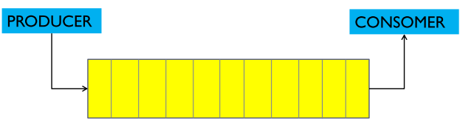
Producer-Consumer Problem
Classic synchronization problems
Also known as bounded-buffer problem
Producer and consumer share a fixed size buffer
Producer produces an item and places it in the shared buffer
Consumer picks an item from the shared buffer and consume it
Regulations
Buffer is FULL → producer will be blocked
Buffer is EMPTY → consumer will be blocked
Only one producer or consumer may access the shared buffer at a time
Fixed-size buffer
Producer
Consumer
...
item
item
item
item
item

Slide 22
Producer-Consumer Solution
Classic synchronization problems
#define N 50
semaphore mutex, empty, full;
init (mutex, 1), init (empty, 0), init (full, N);
producer() {
down(full);
down(mutex);
insertItem(item);
up(mutex);
up(empty);
}
consumer() {
down(empty);
down(mutex);
item = removeItem()
up(mutex);
up(full);
}

Slide 23
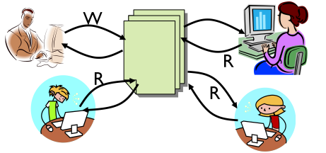
Readers-Writers Problem
Classic synchronization problems
Classic database problem: readers and writers share a database
Regulations
Several readers can read from database at the same time
If a writer is writing to database, other threads cannot access database
If there are any readers in database, a writer cannot access database

Slide 24
Readers-Writers Solution
Classic synchronization problems
semaphore db, mutex;
init (db, 1), init (mutex, 1);
int nReaders = 0;
Reader ( ) {
down(mutex);
if (nReaders==0) down(db);
nReaders+=1;
up(mutex);
readFromDB( );
down(mutex);
nReaders-=1;
if (nReaders==0) up(db);
up(mutex);
}
Writer ( ) {
down(db);
writeToDB( );
up(db);
}

Slide 25
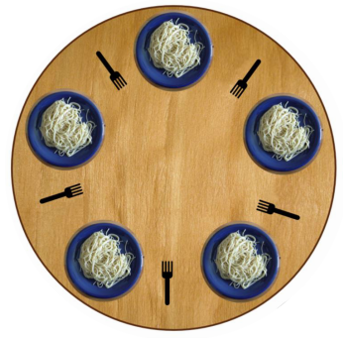
Dining Philosophers Problem
Classic synchronization problems
Five philosophers are seated around a circular table, which is laid with five forks
Each philosopher must take two nearest forks for eating, but:
He can only pick up one fork at a time
He cannot pick up the fork
which has been taken by his neighbors

Slide 26
Dining Philosophers Solution
Classic synchronization problems
semaphore forks[5]; //forks[1, 1, 1, 1, 1]
Philosopher (int i) { //i: philosopher number
while(true) {
down(forks[i]); //take left fork
down(forks[(i + 1)%5]); //take right fork
eating( );
up(forks[i]); //put left fork back
up(forks[(i + 1)%5]); //put right fork back
}
}
What if all five philosophers take left fork at once?
☹ Deadlock

Slide 27
Dining Philosophers Solution (cont.)
Classic synchronization problems
void test (int i) {
if ((state[(i + 4) % 5] != EATING) &&
(state[i] == HUNGRY) &&
(state[(i + 1) % 5] != EATING) ) {
state[i] = EATING ;
self[i].signal () ;
}
}
initialization_code () {
for (int i = 0; i < 5; i++)
state[i] = THINKING;
}
}
monitor DiningPhilosophers
{
enum { THINKING, HUNGRY, EATING };
state [5];
condition self [5];
void pickup (int i) {
state[i] = HUNGRY;
test(i);
if (state[i] != EATING) self[i].wait();
}
void putdown (int i) {
state[i] = THINKING;
// test left and right neighbors
test((i + 4) % 5);
test((i + 1) % 5);
}
☺ No deadlock
DiningPhilosophers.pickup(i);
/** EAT **/
DiningPhilosophers.putdown(i);
☹ Starvation

Slide 28

Topic 1

